Slide 1
Introduction to Data Science
Lecture 8
Machine Learning 1
EMSE 6992 Fall 2019
Ben Harvey

Slide 2
Outline
Supervised Learning
Linear Regression
R-squared
Logistic Regression
SVMs
Gradient-based optimization
Decision Trees and Random Forests
HW Examples

Slide 3
Machine Learning
Supervised: We are given input samples (X) and output samples (y) of a function y = f(X). We would like to “learn” f, and evaluate it on new data. Types:
Classification: y is discrete (class labels).
Regression: y is continuous, e.g. linear regression.
Notes:
regression (predicting a real value) and classification (predicting a discrete value).

Slide 4
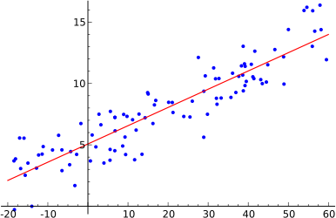
Linear Regression
We want to find the “best” line (linear function y=f(X)) to explain the data.
y
X
Notes:
White box vs. Black Box

Slide 5
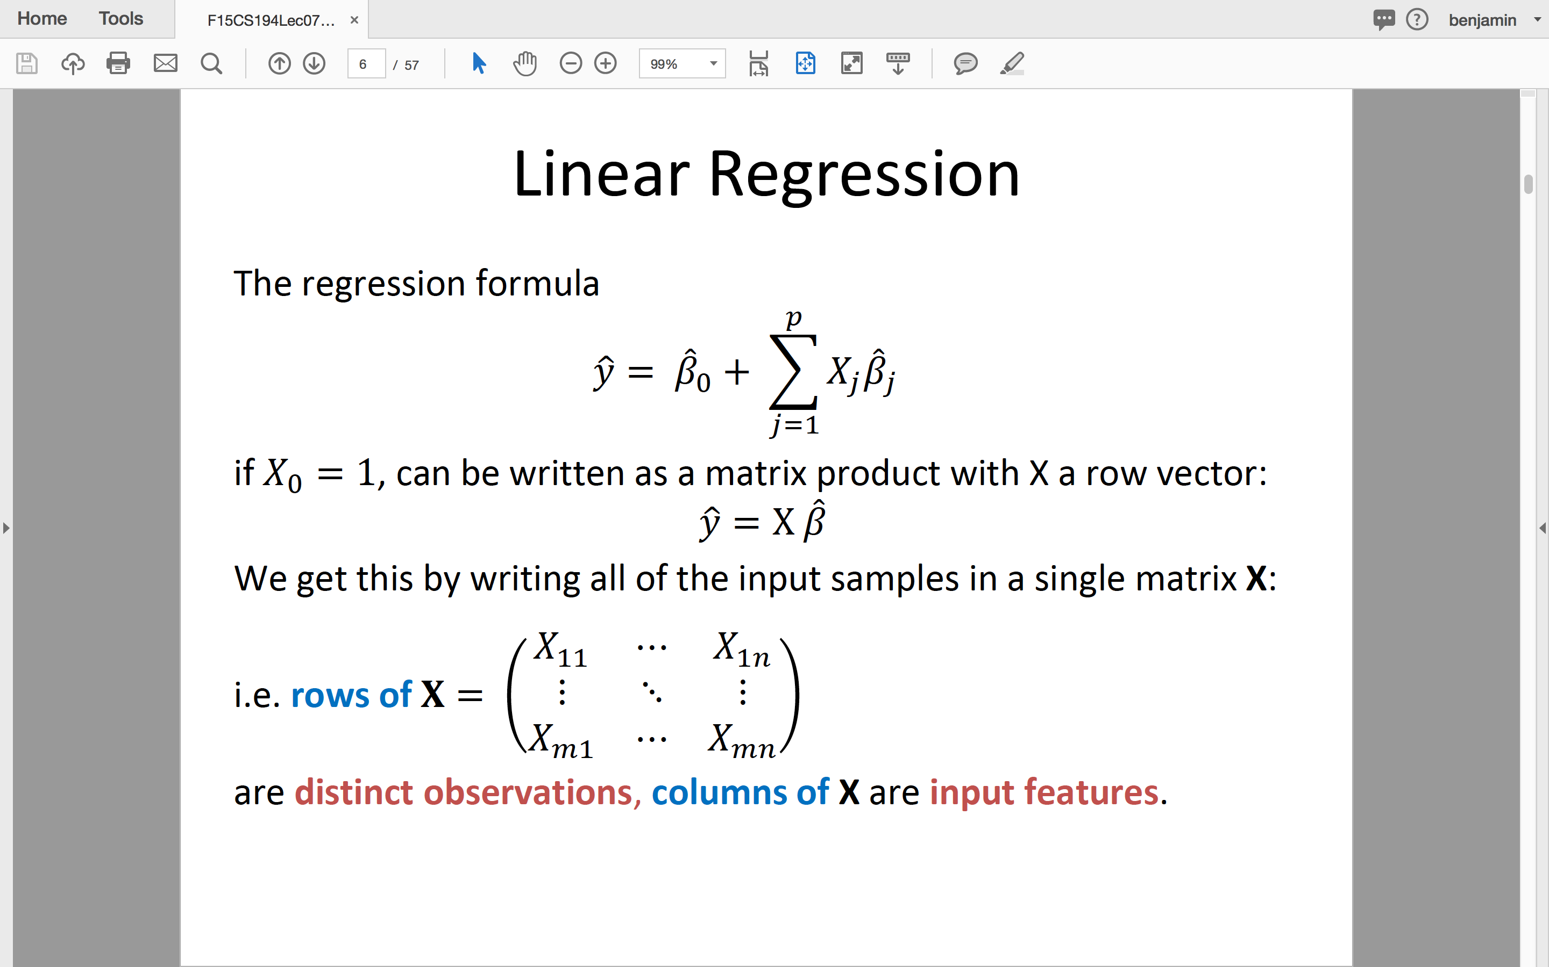
Linear Regression
The predicted value of y is given by:
𝑝
𝑦 = 𝛽₀ +
𝑋_{𝑗}𝛽_{𝑗}
𝑗=1
The vector of coefficients 𝛽 is the regression model.

Slide 6
Linear Regression
The regression formula
𝑝
𝑦 = 𝛽₀ + 𝑋_{𝑗}𝛽_{𝑗}
𝑗=1
if 𝑋₀ = 1, can be written as a matrix product with X a row vector:
𝑦 = X 𝛽
We get this by writing all of the input samples in a single matrix X:
^{𝑋}11 ^{⋯ 𝑋}1𝑛
⋮ ⋱ ⋮
^{𝑋}𝑚1 ^{⋯ 𝑋}𝑚𝑛
i.e. rows of 𝐗 =
are distinct observations, columns of X are input features.

Slide 7
Least Squares Solution
The most common measure of fit between the line and the data is
the least-squares fit.
There is a good reason for this: If the points are generated by an ideal line with additive Gaussian noise, the least squares solution is the maximum likelihood solution.
Probability of a point y_{j} is Pr 𝑦_{𝑗} = exp
− 𝑦_{𝑗}−𝑋_{𝑗}𝛽 ²
and the
2𝜎²
probability for all points is the product over j of Pr 𝑦_{𝑗} .
We can easily maximize the log of this expression
− 𝑦_{𝑗}−𝑋_{𝑗}𝛽 ²
for
2𝜎²
one point, or the sum of this expression at all points.

Slide 8
Least Squares Solution
To determine the model parameters 𝛽 from some data, we write
down the Sum of Squares:
𝑁
SS 𝛽 = 𝑦_{𝑖} − 𝑋_{𝑖}𝛽 ²
𝑖=1
or symbolically SS 𝛽 = 𝐲 − 𝐗𝛽 ^{𝑇} 𝐲 − 𝐗𝛽 . To minimize it, take the derivative wrt 𝛽 which gives:
𝐗^{𝑇} 𝐲 − 𝐗𝛽 = 0
And if 𝐗^{𝑇}𝐗 is non-singular, the unique solution is:
𝛽 =
_{𝐗}𝑇_{𝐗} −1_{𝐗}𝑇_{𝐲}
Notes:
A square matrix that is not singular, i.e., one that has a matrix inverse. Nonsingular matrices are sometimes also called regular matrices. A square matrix is nonsingular iff its determinant is nonzero

Slide 9
Iterative Least Squares
The exact method requires us to invert a matrix 𝐗^{𝑇}𝐗 whose size is M² for M features and takes time O(M³). This is too big for large feature spaces like text or event data.
Gradient methods reduce the SS error using the derivative wrt 𝛽
𝑁
RSS 𝛽 = 𝑦_{𝑖} − 𝛽𝑥_{𝑖} ²
𝑖=1
which is
𝛻 = 𝐗^{𝑇} 𝐲 − 𝐗𝛽
More on this later in this lecture.

Slide 10
Outline
Supervised Learning
Linear Regression
R-squared
Logistic Regression
SVMs
Gradient-based optimization
Decision Trees and Random Forests
HW 2 Examples

Slide 11
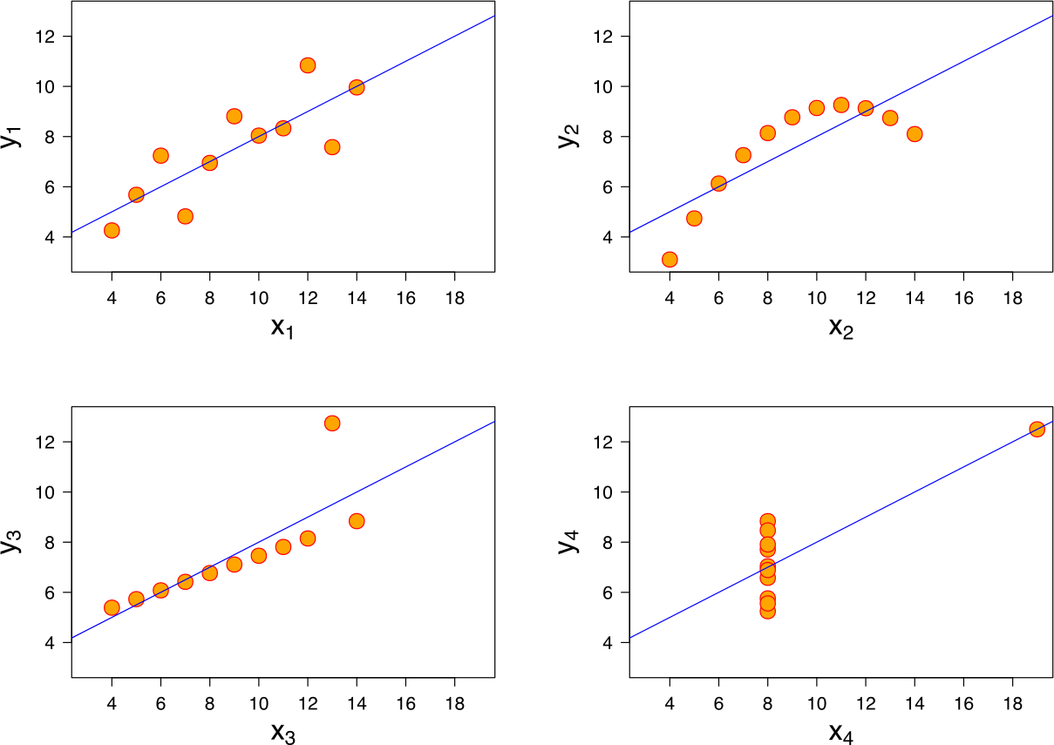
R²-values and P-values
We can always fit a linear model to any dataset, but how do we
know if there is a real linear relationship?

Slide 12
R²-values
Approach: Measure how much the total “noise” (variance) is
reduced when we include the line as an offset.
R-squared: a suitable measure. Let 𝑦 = X 𝛽 be a predicted value, and 𝑦 be the sample mean. Then the R-squared value is
𝑦_{𝑖} − 𝑦_{𝑖} ²
𝑦_{𝑖} − 𝑦 ²
2
𝑅 = 1 −
And can be described as the fraction of the total variance not explained by the model.
R² = 0: bad model. No evidence of a linear relationship. R² = 1: good model. The line perfectly fits the data.

Slide 13
R-squared
₂ Small if good fit
𝑦 − 𝑦
𝑅² = 1 − ^{𝑖 𝑖}
𝑦_{𝑖} − 𝑦 ²
y
Line of 𝑦
Line of 𝑦
X

Slide 14
R²-values and P-values
Statistic: From R-squared we can derive another statistic (using degrees of freedom) that has a standard distribution called an F-distribution.
From the CDF for the F-distribution, we can derive a P-value for
the data.
The P-value is, as usual, the probability of observing the data
under the null hypothesis of no linear relationship.
If p is small, say less than 0.05, we conclude that there is a linear relationship.

Slide 15
Outline
Supervised Learning
Linear Regression
R-squared
Logistic Regression
SVMs
Gradient-based optimization
Decision Trees and Random Forests
HW 2 Examples

Slide 16
Logistic Regression
We made a distinction earlier between regression (predicting
a real value) and classification (predicting a discrete value).
Logistic regression is designed as a binary classifier (output say {0,1}) but actually outputs the probability that the input instance is in the “1” class.
A logistic classifier has the form:
1
𝑝 𝑋 =
𝑋₁, … , 𝑋_{𝑛}
1 + exp −𝑋𝛽
where 𝑋 =
is a vector of features.

Slide 17
Logistic Regression
Logistic regression is probably the most widely used general-
purpose classifier.
Its very scalable and can be very fast to train. It’s used for
Spam filtering
News message classification
Web site classification
Product classification
Most classification problems with large, sparse feature sets.
The only caveat is that it can overfit on very sparse data, so its
often used with Regularization

Slide 18
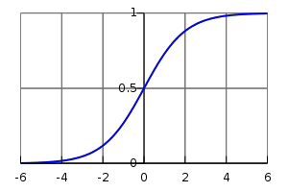
Logistic Regression
Logistic regression maps the “regression” value −𝑋𝛽 in
(-∞,∞) to the range [0,1] using a “logistic” function:
1
𝑝 𝑋 =
1 + exp −𝑋𝛽
i.e. the logistic function maps any value on the real line to a
probability in the range [0,1]

Slide 19
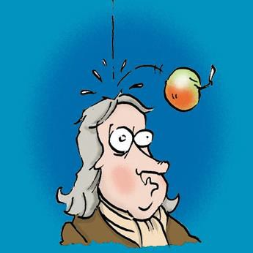
Logistic Regression
Where did the logistic function
come from?

Slide 20
Logistic Regression and Naïve Bayes
Logistic regression is actually a generalization of Naïve Bayes
with binary features.
Logistic Regression can model a Naïve Bayes classifier when the binary features are independent.
Bayes rule for two classes 𝑐 and ¬𝑐:
₌ Pr 𝑋|𝑐 Pr 𝑐 Pr 𝑋|𝑐 Pr 𝑐
Pr 𝑐|𝑋
=
Pr 𝑋 Pr 𝑋|𝑐 Pr 𝑐 + Pr 𝑋|¬𝑐 Pr ¬𝑐
Dividing by the numerator:
1
=
₁ ₊ Pr 𝑋|¬𝑐 Pr ¬𝑐
Pr 𝑋|𝑐 Pr 𝑐

Slide 21
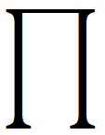
Logistic Regression and Naïve Bayes
We have
1 1
Pr 𝑐|𝑋 =
=
₁ ₊ Pr 𝑋|¬𝑐 Pr ¬𝑐
1 + exp −𝑋𝛽
Pr 𝑋|𝑐 Pr 𝑐
which matches if
Pr 𝑋|¬𝑐 Pr ¬𝑐
= exp −𝑋𝛽
Pr 𝑋|𝑐 Pr 𝑐
and assuming feature independence, the two sides factor as:
Pr ¬𝑐 Pr 𝑐
𝑛 𝑛
Pr 𝑋_{𝑖}|¬𝑐 Pr 𝑋_{𝑖}|𝑐
= exp − 𝛽₀ exp −𝑋_{𝑖} 𝛽_{𝑖}
𝑖=1 𝑖=1
And we can match corresponding (i) terms to define 𝛽.

Slide 22
Logistic Regression and Naïve Bayes
Summary: Logistic regression has this form:
Models Naïve Bayes formula with two classes
after dividing through by one of them
1
Pr 𝑐|𝑋 =
1 + exp −𝑋𝛽
Models product of contributions from different (independent) features

Slide 23
Logistic Regression and Naïve Bayes
Because it can always learn an NB model but is more general,
Logistic regression should do at least as well as naïve Bayes*
Logistic regression typically does better though because it can deal with dependencies between features, whereas Naïve Bayes cannot.
- true if we have sufficient data to reduce variance in the models.
Naive Bayes generally has higher bias due to the independence assumption, but also lower variance than logistic regression.

Slide 24
Logistic Training
For training, we start with a collection of input values 𝑋^{𝑖} and corresponding output labels 𝑦^{𝑖} ∈ 0,1 . Let 𝑝^{𝑖} be the predicted output on input 𝑋^{𝑖}, so
1
1 + exp 𝑋^{𝑖}𝛽
_{𝑝}𝑖
=
The accuracy on an input 𝑋^{𝑖} is
𝐴^{𝑖} = 𝑦^{𝑖}𝑝^{𝑖} + 1 − 𝑦^{𝑖} 1 − 𝑝^{𝑖}
Logistic regression maximizes either the sum of the log accuracy,
or the total accuracy, e.g.
𝑁
𝐴 = log 𝐴^{𝑖}
𝑖=1

Slide 25
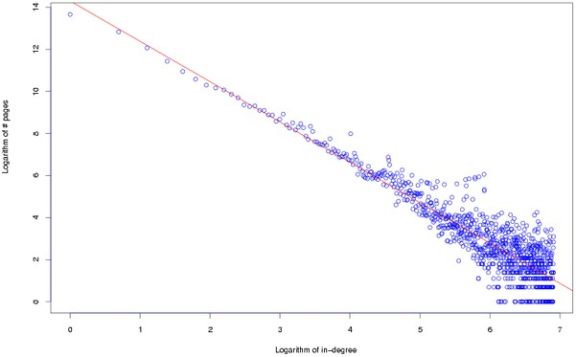
Logistic Regression Training - SGD
A very efficient way to train logistic models is with Stochastic Gradient Descent (SGD) – we keep updating the model with gradients from small blocks (mini-batches) of input data.
One challenge with training on power law data (i.e. most data) is that the terms in the gradient can have very different strengths (because of the power law distribution). We’ll discuess this soon…

Slide 26
Outline
Supervised Learning
Linear Regression
R-squared
Logistic Regression
SVMs
Gradient-based optimization
Decision Trees and Random Forests
HW 2 Examples

Slide 27
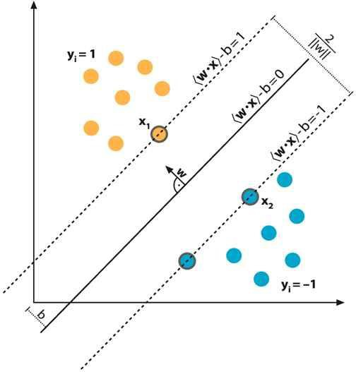
Support Vector Machines
A Support Vector Machine (SVM) is a classifier that tries to maximize the margin between training data and the classification boundary (the plane defined by 𝑋𝛽 = 0)

Slide 28




Support Vector Machines
The idea is that maximizing the margin maximizes the chance that classification will be correct on new data. We assume the new data of each class is near the training data of that type.

Slide 29
SVM Training
SVMs can be trained using SGD.
The SVM gradient can be defined as (here 𝑝^{𝑖} = 𝑋^{𝑖}𝛽)
𝑁
𝑑𝐴 ₌
if 𝑝^{𝑖}𝑦^{𝑖} < 1 then 𝑦^{𝑖}𝑋^{𝑖} else 0
𝑑𝛽
𝑖=1
The expression 𝑝^{𝑖}𝑦^{𝑖} < 1 tests whether the point 𝑋^{𝑖} is nearer than the margin, and if so adds it with sign 𝑦^{𝑖}. This “nudges” the model to push it further out next time. It ignores other points.

Slide 30
SVM Training
This SGD training method (called Pegasos) is much faster than
previous methods, and competitive with Logistic Regression.
Its also capable of training in less than one pass over a dataset.

Slide 31
Outline
Supervised Learning
Linear Regression
R-squared
Logistic Regression
SVMs
Gradient-Based Optimization
Decision Trees and Random Forests
HW2 Examples

Slide 32
Newton’s Method
Newton’s method is the classical approach to iterative
optimization. In vector/matrix form it is:
𝑋¹ = 𝑋⁰ − 𝐻_{𝑓}⁻¹ 𝑋⁰ 𝐺_{𝑓} 𝑋⁰
𝑑𝑓
Where 𝐺_{𝑓} = _{𝑑𝑋𝑖} is the gradient and
𝐻 =
𝑑²𝑓
(a matrix) is the Hessian.
𝑓
𝑑𝑋_{𝑖}𝑑𝑋_{𝑗}
Newton’s method converges very fast when its feasible. But there are several challenges to using it with large datasets.

Slide 33
Challenges for Newton’s Method
Both the gradient and Hessian are normally computed on the entire dataset. This means many passes over the data to complete a series of Newton steps.
The Hessian has size O(M²) if there are M features. This is impractical for large feature spaces, e.g. text or event data.
One Solution is L-BFGS, which stands for “Limited Memory Broyden-Fletcher-Goldfarb-Shanno”. It’s a Newton-like algorithm that use an approximation to the Hessian with only a few rows.
L-BFGS still requires full passes over the dataset however.

Slide 34
Stochastic Gradient
A very important set of iterative algorithms use stochastic
gradient updates.
They use a small subset or mini-batch X of the data, and use it to compute a gradient which is added to the model
𝛽′ = 𝛽 + 𝛼 𝛻
Where 𝛼 is called the learning rate.
These updates happen many times in one pass over the dataset. Its possible to compute high-quality models with very few passes,
sometime with less than one pass over a large dataset.

Slide 35
Challenges for Stochastic Gradient
Stochastic gradient has some serious limitations however, especially if the gradients vary widely in magnitude. Some coefficients change very fast, others very slowly. (The Hessian corrects for this in Newton’s method).
This happens for text, user activity and social media data (and other power-law data), because gradient magnitudes scale with feature frequency, i.e. over several orders of magnitude.
Its not possible to set a single learning rate that trains the frequent and infrequent features at the same time.

Slide 36
ADAGRAD – Adaptive-rate SGD
ADAGRAD is a particularly simple and fast approach to this
problem. The gradient 𝑔_{𝑡} at the t^{th} step is scaled as
𝑔_{𝑡}
𝑡
𝑘=1
_{𝑔𝑘}2
Where 𝑔_{𝑘}² is the k^{th} gradient vector squared element-wise.
This corrects for feature scale factors, and all ADAGRAD-scaled
gradient components have similar magnitudes.
ADAGRAD often improves SGD convergence on power-law data
by orders of magnitude.

Slide 37
SGD learning rate schedules
With ADAGRAD gradients are scaled by
1
𝑡
𝑘=1
_{𝑔𝑘}2
Which is proportional to 𝑡^{−0.5} assuming gradient magnitudes are roughly constant. This inverse power rate is quite efficient for “easy” learning problems like linear or logistic regression.

Slide 38
SGD learning rate schedules
For harder (non-convex) learning problems, its common to use
learning rate schedules that decay more slowly, or not at all.
Exponential schedule: 𝑙 = 𝑙₀exp − ^{𝑡} 𝜏 starting with an initial learning rate 𝑙₀, the rate decreases by a factor of e for each interval of learning 𝜏.
Constant schedule: 𝑙 = 𝑙₀ is good for very complex learning
problems, e.g. multi-layer neural networks.
Linear schedule: 𝑙 = 𝑙₀ where T_{final} is the final
^{1 − 𝑡 𝑇}𝑓𝑖𝑛𝑎𝑙
value of t. Uses a fast initial rate to move close to the final
optimum, and then slows to reduce variance.

Slide 39
5-minute break

Slide 40
Outline
Supervised Learning
Linear Regression
R-squared
Logistic Regression
SVMs
Gradient-based optimization
Decision Trees and Random Forests
HW 2 Examples

Slide 41
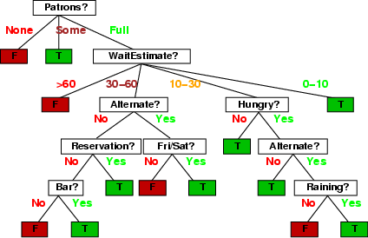
Decision trees
Walk from root to a class-labeled leaf.
At each node, branch based on the value of some feature.
Ex: Should we wait for a table at this restaurant?
Note you can use the same attribute more than once.

Slide 42
Decision tree learning
If there are k features, a decision tree might have up to 2^{k} nodes. This is usually much too big in practice.
We want to find “efficient” (smaller) trees.
We can do this in a greedy manner by recursively choosing a best split feature at each node.

Slide 43
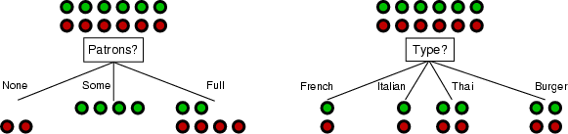
Choosing an attribute
Idea: a good features splits the examples into subsets that are
(ideally) "all positive" or "all negative"
Patrons or type?
To wait or not to wait is still at 50%.

Slide 44
Using Information Theory
Entropy is defined at each node based on the class
breakdown:
Let 𝑝_{𝑖} be the fraction of examples in class i.
Let 𝑝^{𝑓}be the fraction of elements with feature f that
𝑖
lie in class i.
Let 𝑝^{¬𝑓}be the fraction of elements without feature f
𝑖
that lie in class i
Finally let 𝑝^{𝑓} and 𝑝^{¬𝑓} be the fraction of nodes with
(respectively without) feature f

Slide 45
Information Gain
Before the split by f, entropy is
𝑚
𝐸 = − 𝑝_{𝑖} log 𝑝_{𝑖}
𝑖=1
After split by f, the entropy is
𝑚
𝑚
𝐸_{𝑓} = −𝑝^{𝑓} 𝑝^{𝑓} log 𝑝^{𝑓} − 𝑝^{¬𝑓}
𝑖 𝑖
𝑝^{¬𝑓} log 𝑝^{¬𝑓}
𝑖 𝑖
𝑖=1
𝑖=1
The information gain = 𝐸 − 𝐸_{𝑓} (information = -entropy)

Slide 46




Example
P = (0.5,0.25,0.25)
P = (0.5,0.25,0.25)
AAAA
BB
CC
Classes A, B, C
AAAA
BB
CC
Split by Patrons feature
Split by
Type feature
AA
AA
AA
AA
B
B
BB
C
C
CC
(0.5,0.25,0.25) (0.5,0.25,0.25)
(0.5,0,0.5) (0.5,0.5,0)

Slide 47
Example
P = (0.5,0.25,0.25)
P = (0.5,0.25,0.25)
AAAA
BB
CC
Classes A, B, C
AAAA
BB
CC
Split by Patrons feature
Split by
Type feature
AA
AA
AA
AA
B
B
BB
C
C
CC
(0.5,0.25,0.25) (0.5,0.25,0.25)
(0.5,0,0.5) (0.5,0.5,0)
Before: E = 1.5 bits After:
𝐸_{𝑓} = (0.5+0.5)*1 bits = 1 bits Gain = 𝐸 − 𝐸_{𝑓} = 0.5 bits
𝐸 = −
𝑝_{𝑖} log 𝑝_{𝑖} =
0.5*1+0.25*2+0.25*2 = 1.5 bits
After:
𝐸_{𝑓} = (0.5+0.5)*1.5= 1.5 bits No gain!

Slide 48
Example
AAAA
BBB
CCC
Classes A, B, C
AAAA
BBB
CCC
Split by Patrons feature
Split by
Type feature
AA
AA
AA
AA
BB
B
BBB
C
CC
CCC

Slide 49
Choosing best features
At each node, we choose the feature f which maximizes the
information gain.
This tends to be produce mixtures of classes at each node that
are more and more “pure” as you go down the tree.
If a node has examples all of one class c, we make it a leaf and output “c”. Otherwise, when we hit the depth limit, we output the most popular class at that node.

Slide 50


Decision Tree Models
As tree depth increases, bias decreases and variance generally
increases. Why? (Hint: think about k-NN)
Bias decreases with tree depth
Variance increases with tree depth

Slide 51
Ensemble Methods
Are like Crowdsourced machine learning algorithms:
Take a collection of simple or weak learners
Combine their results to make a single, better learner Types:
Bagging: train learners in parallel on different samples of the data, then combine by voting (discrete output) or by averaging (continuous output).
Stacking: combine model outputs using a second-stage
learner like linear regression.
Boosting: train learners on the filtered output of other
learners.

Slide 52
Random Forests
Grow K trees on datasets sampled from the original dataset with
replacement (bootstrap samples), p = number of features.
Draw K bootstrap samples of size N
Grow each Decision Tree, by selecting a random set of m out of p
features at each node, and choosing the best feature to split on.
Aggregate the predictions of the trees (most popular vote) to produce the final class.
Typically m might be e.g. sqrt(p) but can be smaller.

Slide 53
Random Forests
Principles: we want to take a vote between different learners so we don’t want the models to be too similar. These two criteria ensure diversity in the individual trees:
Draw K bootstrap samples of size N:
Each tree is trained on different data.
Grow a Decision Tree, by selecting a random set of m out of p features at each node, and choosing the best feature to split on.
Corresponding nodes in different trees (usually) cant use the same features to split

Slide 54
Random Forests
Very popular in practice, probably the most popular classifier
for dense data (<= a few thousand features)
Easy to implement (train a lot of trees). Good match for MapReduce.
Parallelizes easily (but not necessarily efficiently).
Not quite state-of-the-art accuracy – DNNs generally do better, and sometimes gradient boosted trees.
Needs many passes over the data – at least the max depth of
the trees. (<< boosted trees though)
Easy to overfit – hard to balance accuracy/fit tradeoff.

Slide 55
Boosted Decision Trees
A recently-developed alternative to random Forests:
In contrast to RFs whose trees are trained independently, BDT trees are trained sequentially by boosting: Each tree is trained on weighted data which emphasizes incorrectly-labeled instances by the previous trees.
Both methods can produce very high-quality models. Superiority of one method or the other is very dataset- dependent.
Resource requirements are very different as well, so its actually non-trivial to compare the methods (what resources do you fix during the experiment?).

Slide 56
Random Forests vs Boosted Trees
The “geometry” of the methods is very different (MNIST data):
Random forest use 10’s of deep, large trees:
Depth
20-30
…
100k’s of nodes
Bias reduction through depth
10’s of trees
Variance reduction through the ensemble aggregate

Slide 57
Random Forests vs Boosted Trees
The “geometry” of the methods is very different (MNIST data):
Boosted decision trees use 1000’s of shallow, small trees:
…
Depth 10-15
1k’s of nodes
1000’s of trees
Bias reduction through boosting – variance already low

Slide 58
Random Forests vs Boosted Trees
RF training embarrassingly parallel, can be very fast
Evaluation of trees (runtime) also much faster for RFs
Depth 20-30
…
100k’s of nodes
10’s of trees
…
Depth 10-15
1k’s of nodes
1000’s of trees

Slide 59
Take-aways
Beware HiPPOs and folklore about ML methods – especially
those that consider one dimension of performance:
Naïve Bayes vs. Logistic Regression
Random Forests vs. Boosted Decision Trees
Always try out all the plausible methods whenever possible.
Make sure you understand the principles and characteristics of the methods you are using. And make sure to tune each method thoroughly - it can make a huge difference to performance.

Slide 60
Model Quality
Almost every model optimizes some quality criterion:
For linear regression it was the Residual Sum-of-Squares
For k-Means it is the “Inertia” – the mean squared distance from each sample to its cluster center.
…
The quality criterion is chosen often because of its good properties:
Convexity: so that there is a unique, best solution
Closed form for the optimum (linear regression) or at least for the gradient (for SGD).
An algorithm that provably converges.

Slide 61
Model Quality
There are typically other criteria used to measure the quality of models. e.g. for clustering models:
Silhouette score
Inter-cluster similarity (e.g. mutual information)
Intra-cluster entropy
For regression models:
Stability of the model (sensitivity to small changes)
Compactness (sparseness or many zero coefficients)

Slide 62
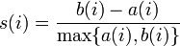
Evaluating Clusterings: Silhouette
The silhouette score is
where a(i) is the mean distance from sample i to its own cluster,
b(i) the mean distance from i to the second-closest cluster.
Perhaps surprisingly, silhouette scores can be, and often are, negative.

Slide 63
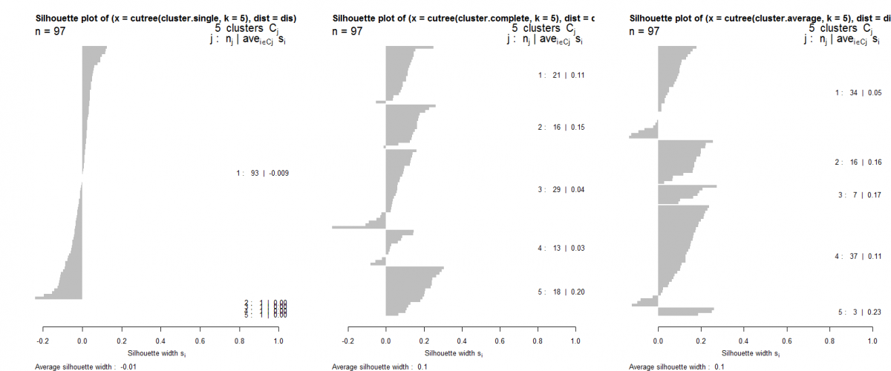
Evaluating Clusterings: Silhouette
Silhouette plot: horizontal bars with cluster score.
Sort (vertically) first by cluster, then by score.

Slide 64
Regularization with Secondary Criteria
While secondary criteria can be measured after the model is built, its too late then to affect the model.
Using secondary criteria during the optimization process is called “regularization”.
Examples:
L1 regularization adds a term to the measure being optimized which is the sum of absolute value of model coefficients.
L2 regularization adds a term to the measure being optimized which is the sum of squares of model coefficients.

Slide 65
Regularization with Secondary Criteria
L1 regularization in particular is very widely used. It has the following impacts:
Yields a convex optimization problem in many cases, so there is a unique solution.
The solution is usually stable to small input changes.
The solution is quite sparse (many zero coefficients) and requires less disk and memory to run.
L1 regularization on factorization models tends to decrease the correlation between model factors.

Slide 66
Outline
Supervised Learning
Linear Regression
R-squared
Logistic Regression
SVMs
Gradient-based optimization
Decision Trees and Random Forests
HW 2 Examples

Slide 67
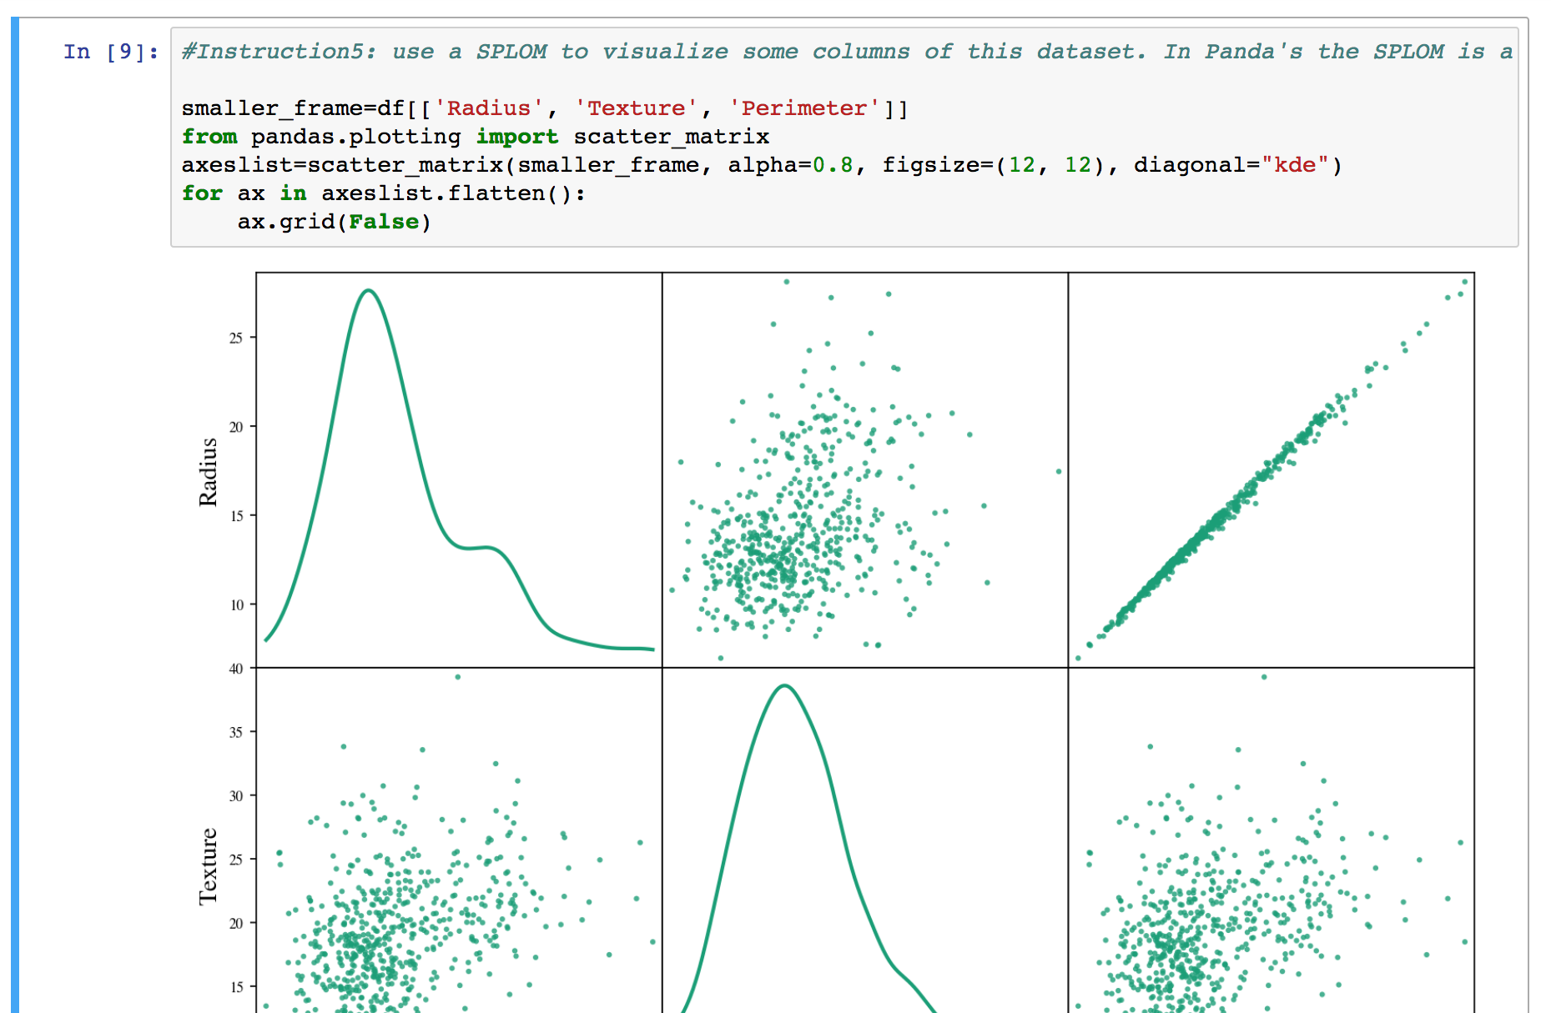
SPLOM

Slide 68
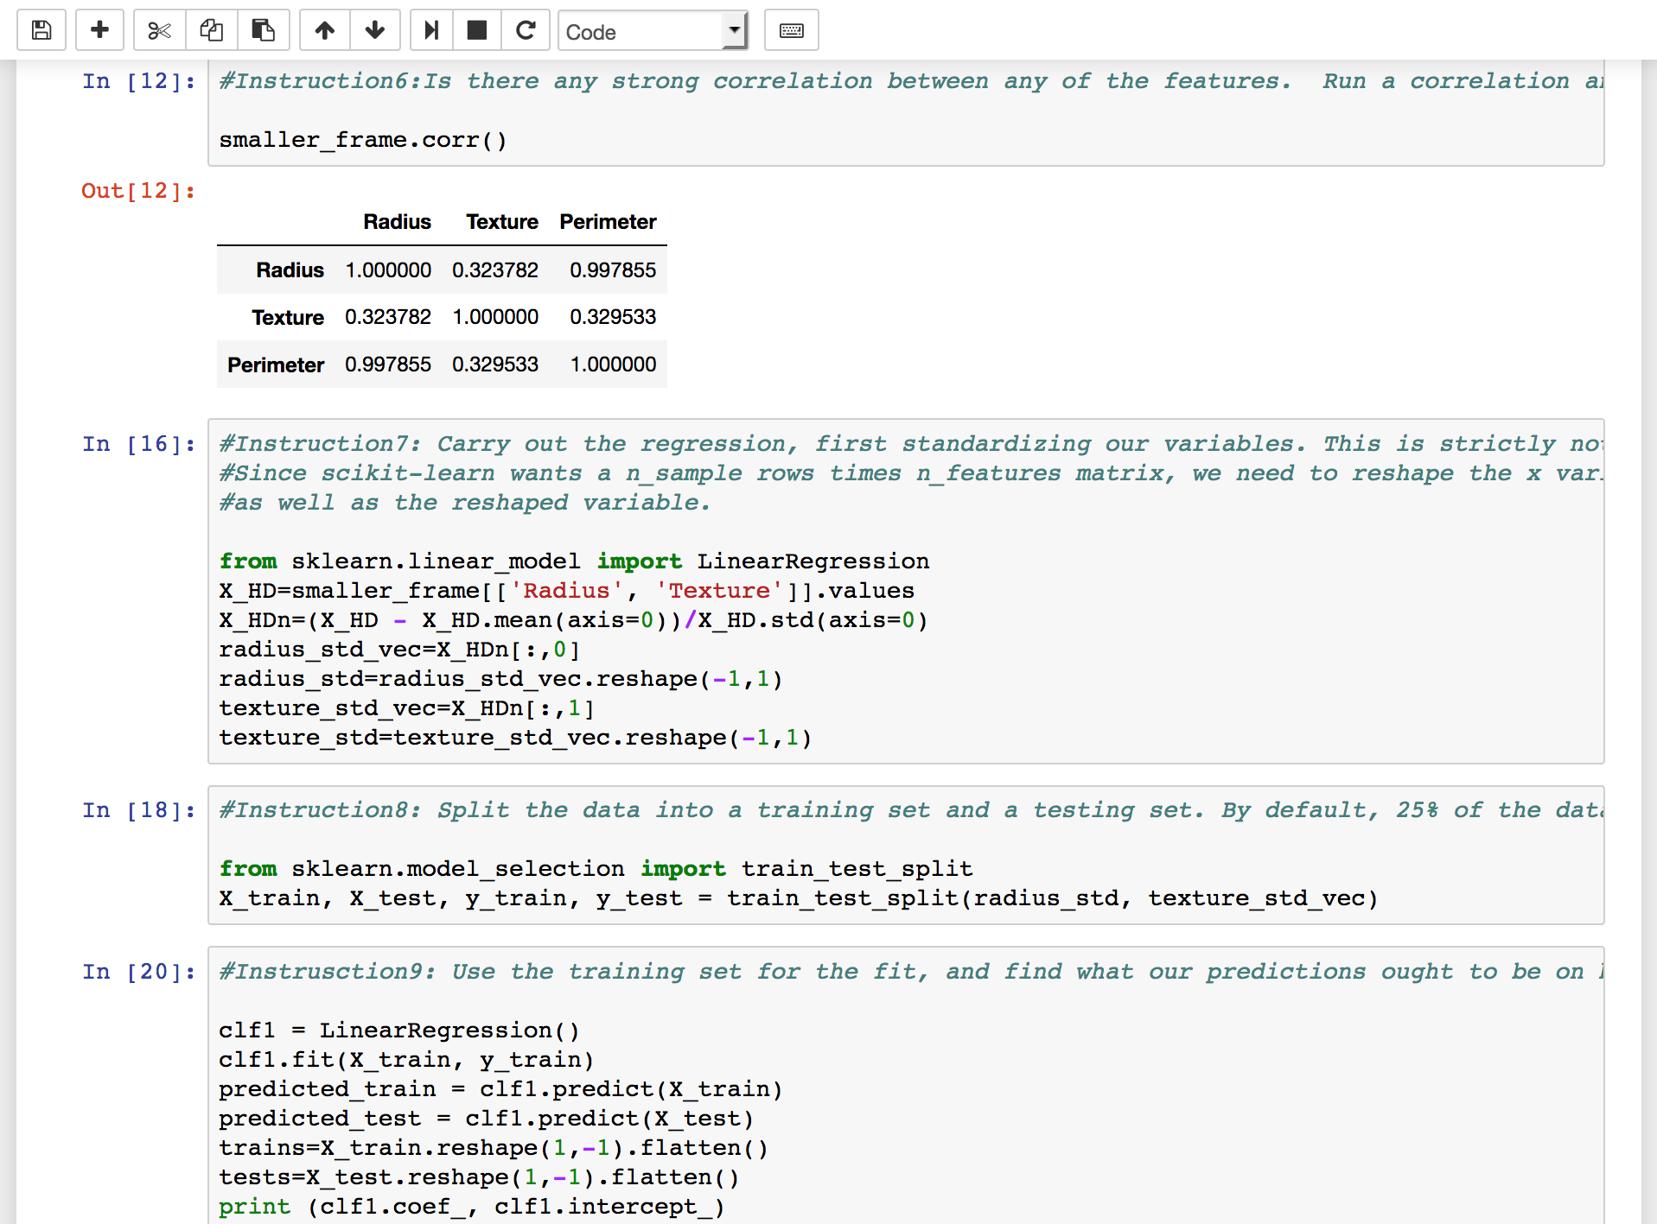
Linear Regression

Slide 69
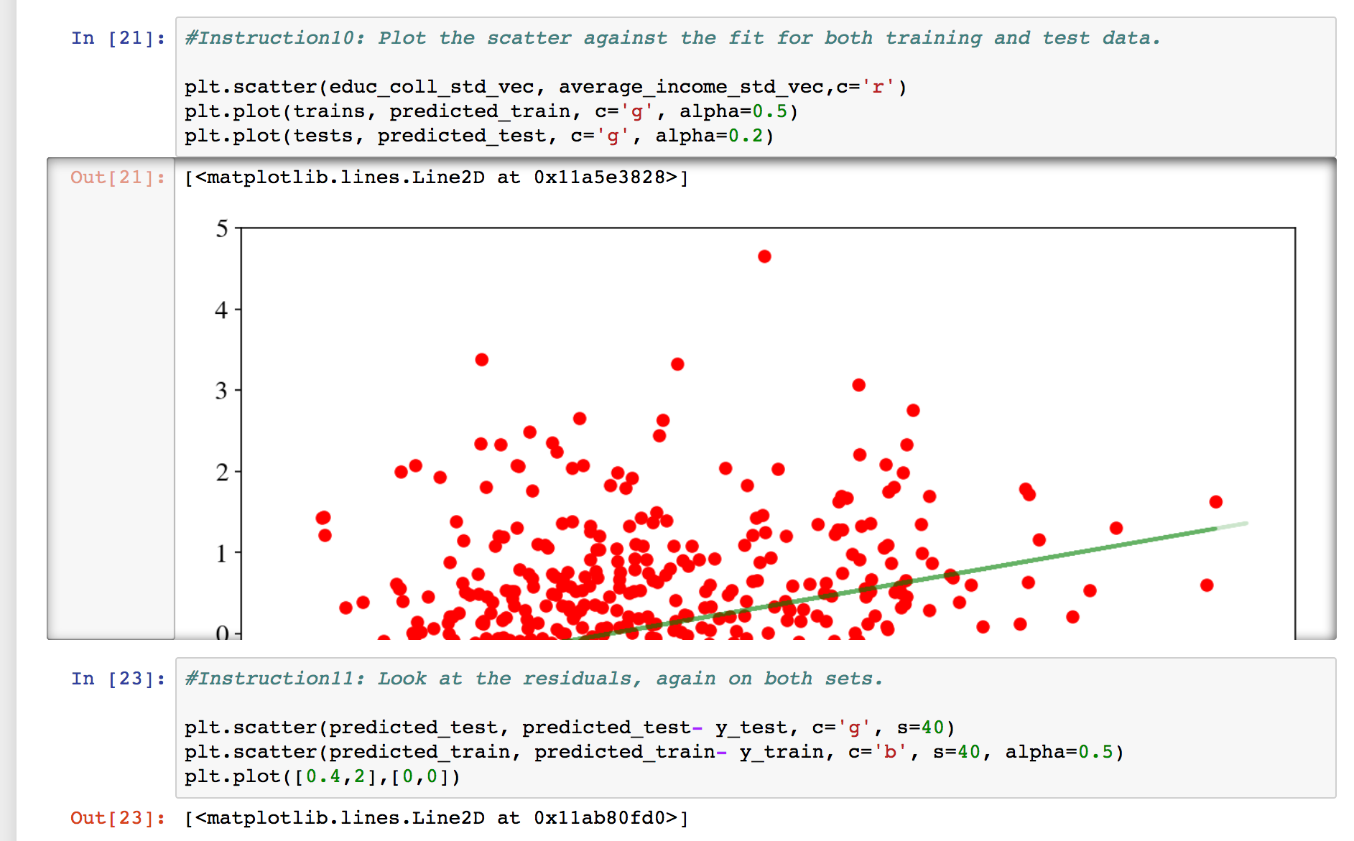
Linear Regression

Slide 70
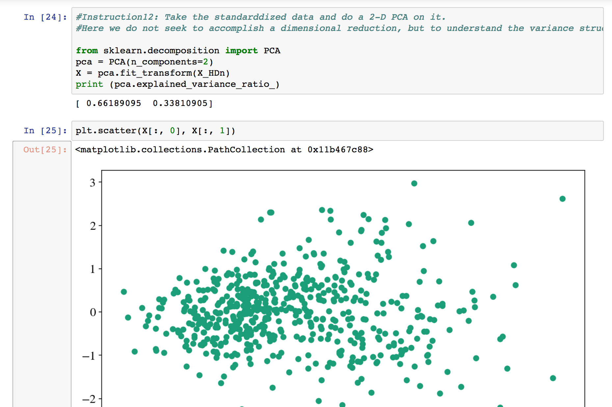
PCA

Slide 71
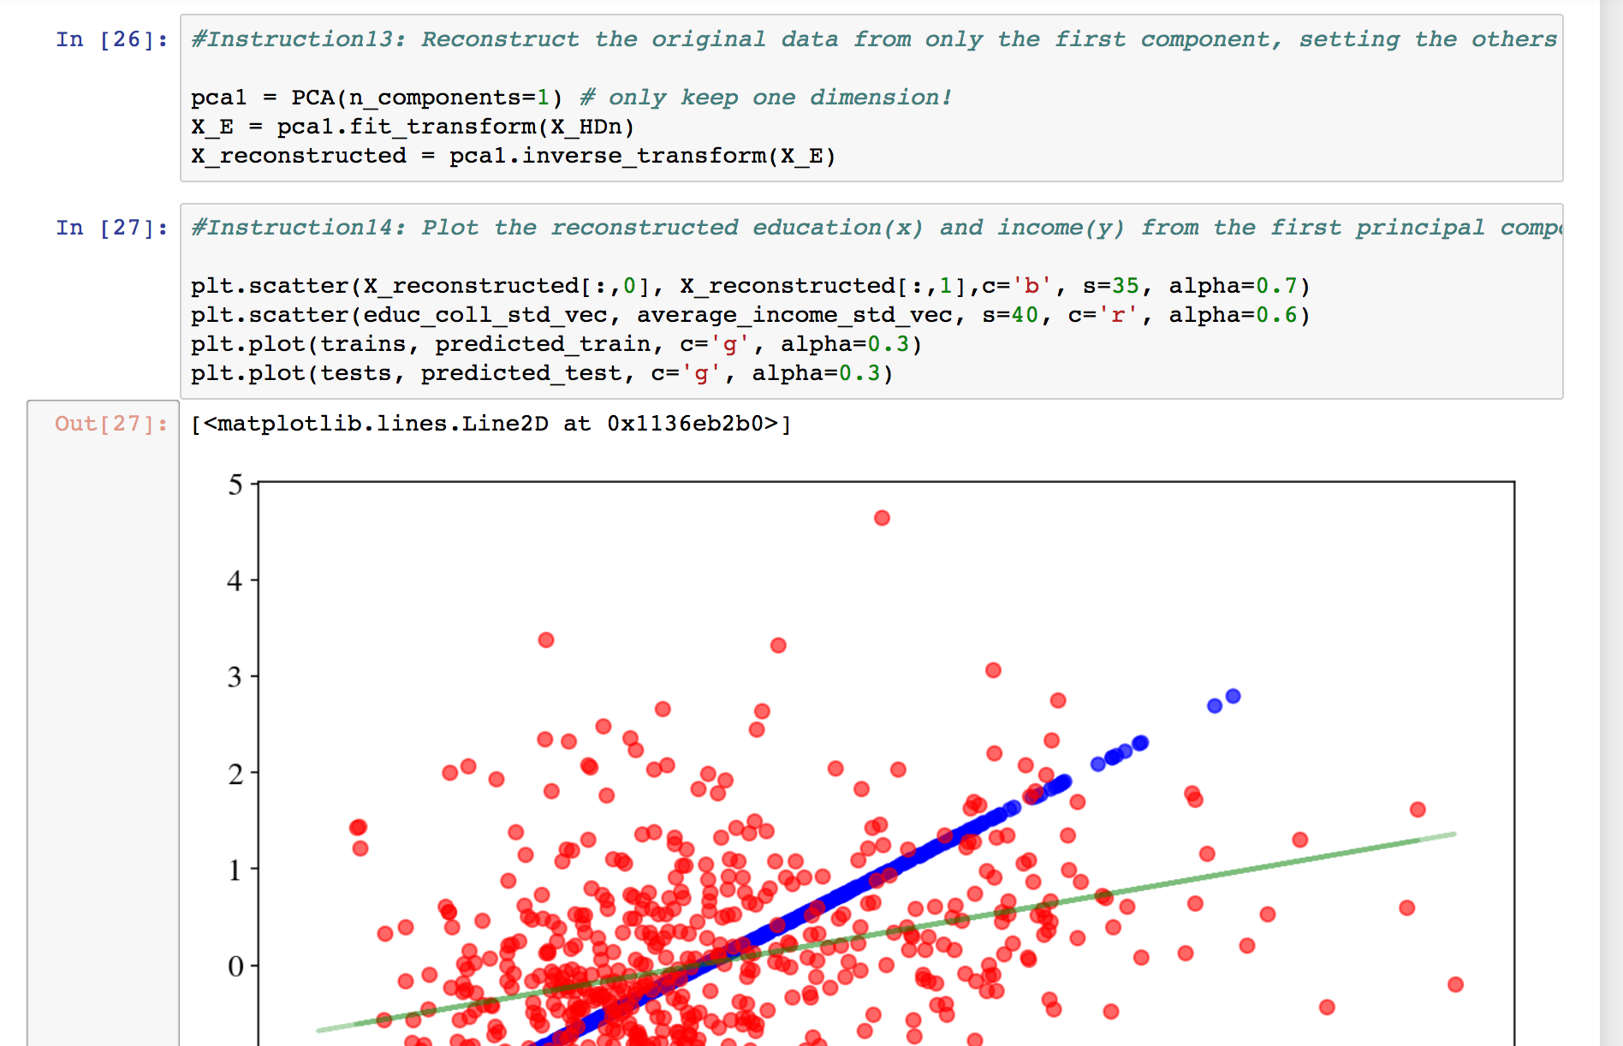
PCA

Slide 72
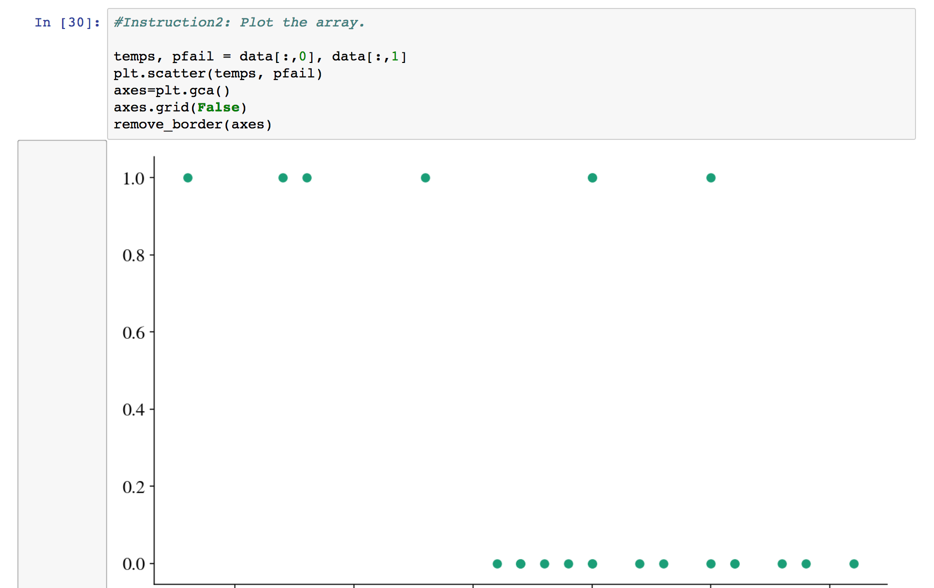
Plotting

Slide 73
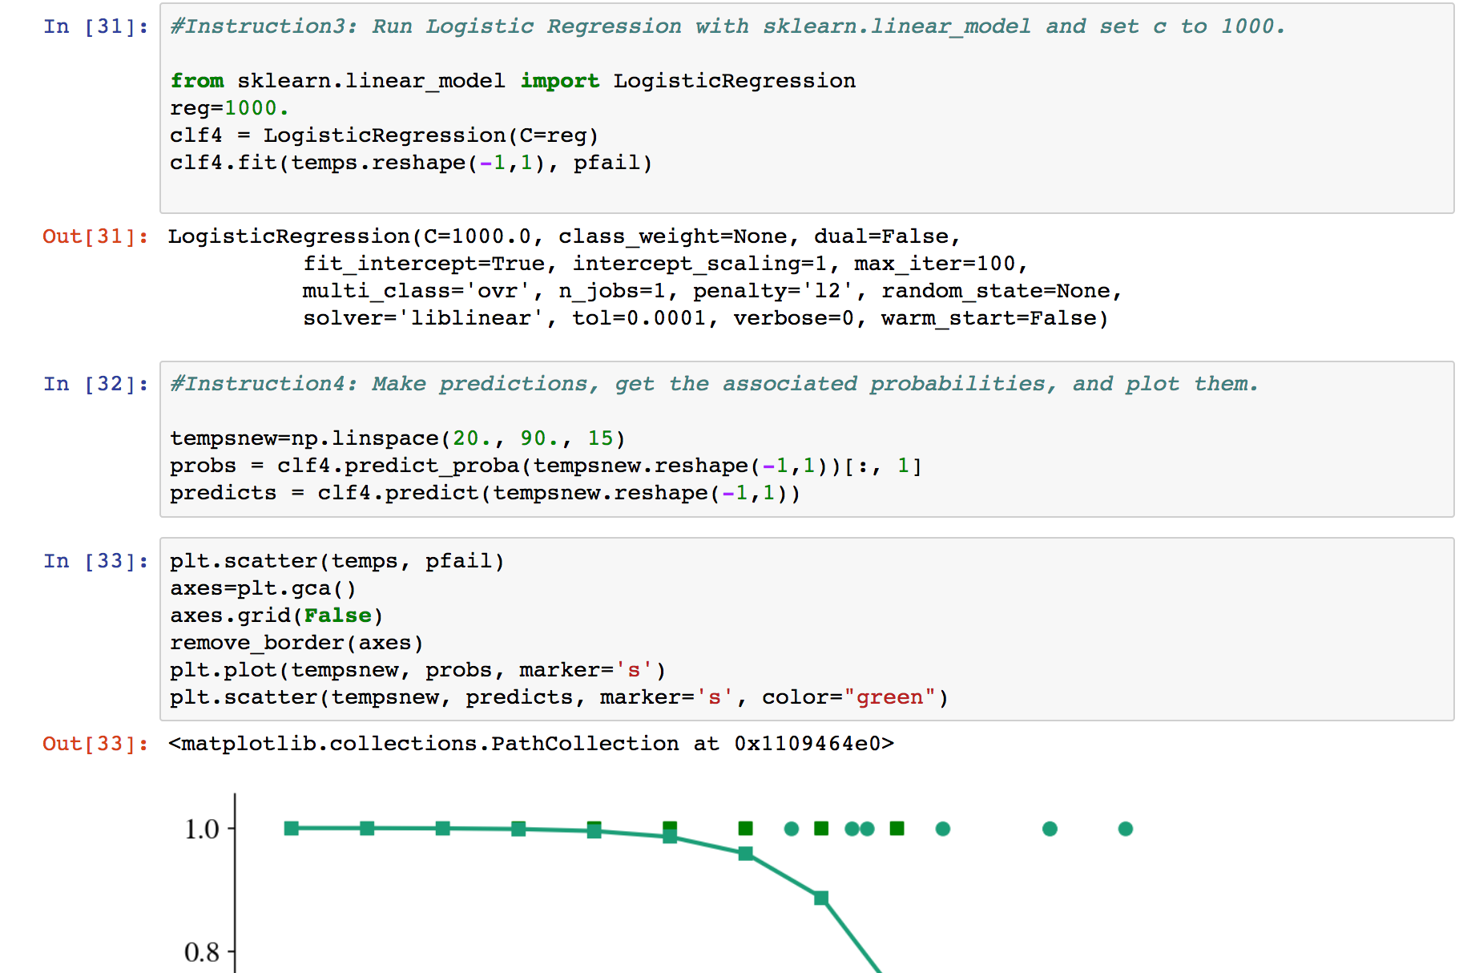
Logistic Regression

Slide 74
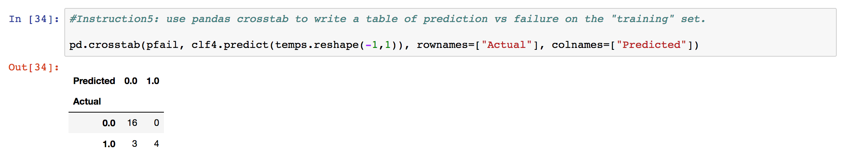
Validation

